Slide 1





USAID ECONOMIC DEVELOPMENT, GOVERNANCE AND ENTERPRISE GROWTH PROJECT (EDGE)
USAID PROJECT - PARTNERSHIP FOR BETTER BUSINESS REGULATION

Slide 2
Workforce Assessment Report – ICT Industry
Objective:
To provide a comprehensive picture of the constraints and challenges of the companies in the ICT industry, in the region of Western Balkans, in relation to skills and availability of labor they need to operate effectively and to grow and to offer recommendations for improvements.
Methodology:
Online survey of 134 ICT companies
Direct interviews with ICT companies
Direct interviews with business associations
Data from:
  State Statistical Offices of Individual Countries;
  Data from other available reports and studies (including WTO, World Bank etc.).

Slide 3
CONTENTS
ICT industry in the countries of Western Balkans Region
Education system
Online survey of ICT companies
Interviews
  Experiences and challenges before the ICT companies
  Role of the associations
Conclusions
Recommendations

Slide 4
ICT INDUSTRY IN THE WESTERN BALKANS

Slide 5
ICT Industry in the Western Balkans Region
Steady growth in the last five years
Important employer
Increase in exports of ICT services
An industry with an important contribution to the GDP

Slide 6
ICT Industry in the Western Balkans Region
Sources: Individual countries’ statistical offices (online statistical databases)

Slide 7
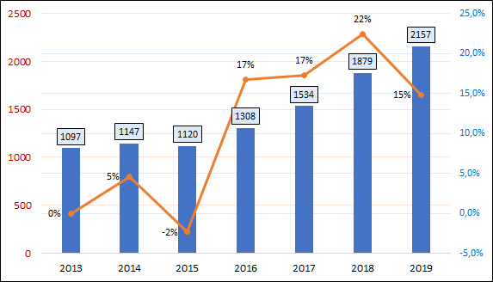
ICT Industry in the Western Balkans Region
Commercial services exports by sector and partner - BOP6 - SI - Telecommunications, computer, and information services * ($US million)
Source: WTO, data.wto.org, accessed on November 30, 2020
*Countries included: Albania, Bosnia and Herzegovina, Montenegro, North Macedonia, Serbia

Slide 8
ICT Industry in the Western Balkans Region
BOP6 - SI - Telecommunications, computer, and information services - exports
(US$ per 100 people)
Serbia
Montenegro
North Macedonia
Bosnia and Herzegovina
Kosovo
Albania
Source: World Bank, https://tcdata360.worldbank.org, accessed on December 07, 2020

Slide 9
ICT Industry in the Western Balkans Region
BOP6 - SI - Telecommunications, computer, and information services - exports
(US$ per 100 people)
Slovenia
Serbia
Montenegro
North Macedonia
Bosnia and Herzegovina
Albania
Kosovo
Source: World Bank, https://tcdata360.worldbank.org, accessed on December 07, 2020

Slide 10
ICT Industry in the Western Balkans Region
*Fixed broadband subscriptions (per 100 people)
Source: WTO, data.wto.org, accessed on November 30, 2020
*Countries included: Albania, Bosnia and Herzegovina, Montenegro, North Macedonia, Serbia (and Slovenia)

Slide 11
EDUCATION SYSTEMS IN WESTERN BALKANS

Slide 12
Education System in Western Balkans
Formal and informal education
The formal education system consists of
  Primary Education
  Secondary Education
  Vocational & Post-secondary Non-Tertiary
  Tertiary Education
Bologna programs are applied at the universities in the region.

Slide 13
Education System in Western Balkans
About *27% of the graduates (26000 graduates) from tertiary education in the Western Balkans Region come from:
  Science, Technology, Engineering and Mathematics programs (23%)
  Natural Sciences, Mathematics and Statistics programs (4%)
Annual number of graduated students from tertiary education in the ICT is about 9% of the total number of graduated students or about 8500 ICT graduates.
*Source: World Bank, https://databank.worldbank.org, accessed on December 1, 2020

Slide 14
LABOR MARKET ICT

Slide 15
ICT in the Western Balkans Region - Labor Market
In 2018 ICT sector employed about 150,000 people
  approx. 2.9% of all registered employees in the region
  The number of employees is even larger if we take into consideration ICT experts employed in other companies (larger production companies, banks, government)
Table: Number of employees in ICT
* Estimated
Sources: Individual countries’ statistical offices (online statistical databases)

Slide 16
ICT in the Western Balkans Region - Labor Market
ICT - average net wages by country (in Euro)
ICT - average net wages by subsector (in Euro)
Sources: Individual countries’ statistical offices (online statistical databases)

Slide 17
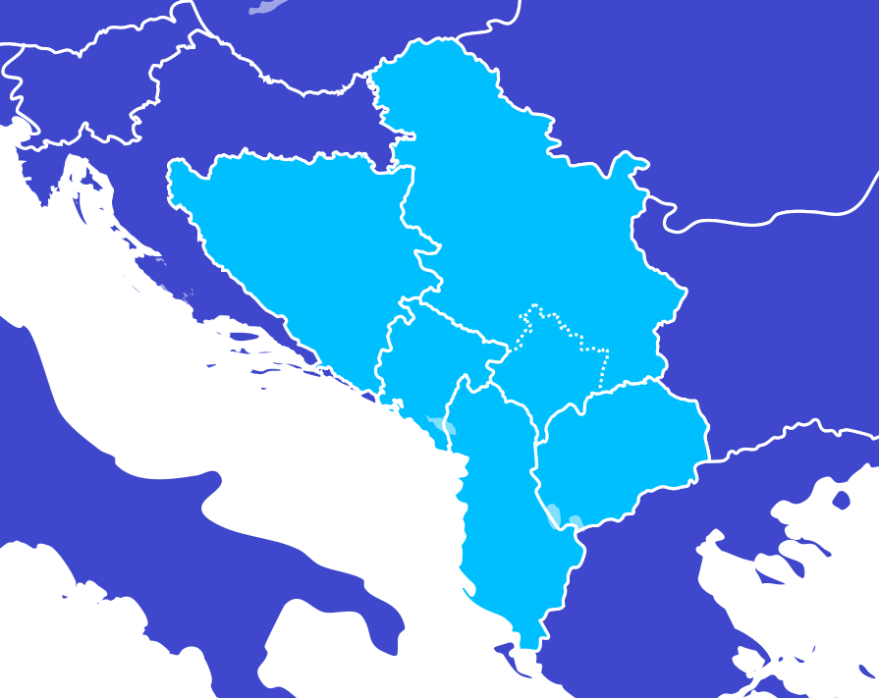
ICT Industry in the Western Balkans Region
Data for 2018
BOSNIA AND HERZEGOVINA:
ICT % of GDP: 4.12
IT % of GDP: 1.62
ICT % of all employees : 3.76% (21,518)
# of ICT companies: 1468
ICT services exports: 159 million $US
SERBIA:
ICT % of GDP: 4.8
IT % of GDP: 1.9
ICT % of all employees: 3.1% (63,935)
# of ICT companies: 4935
ICT services exports: 1592 million $US
MONTENEGRO:
ICT % of GDP: 3.69
IT % of GDP: n/a
ICT % of all employees : 2.77% (5,274)
# of ICT companies: n/a
ICT services exports: 63 million $US
KOSOVO:
ICT % of GDP: 1.9
IT % of GDP: n/a
ICT % of all employees: n/a (9,600 est.)
# of ICT companies: 982
ICT services exports: n/a
ALBANIA:
ICT % of GDP: 3.26
IT % of GDP: 0.67
ICT % of all employees : 2.8% (32,000 est.)
# of ICT companies: 2483
ICT services exports: 108 million $US
NORTH MACEDONIA:
ICT % of GDP: 2.9
IT % of GDP: 1.26
ICT % of all employees : 2.02% (15,303)
# of ICT companies: 1856
ICT services exports: 235 million $US
Sources: Individual countries’ statistical offices (online statistical databases);
World Trade Organization (https://data.wto.org)

Slide 18
ONLINE SURVEY OF ICT COMPANIES

Slide 19
Characteristics of respondents
Survey of ICT companies
134 companies surveyed (1.04% of all ICT enterprises in the WB region, or 2.06% of enterprises in the computer programming and consultancy segment)
Size of surveyed companies:
30% micro (40)
51% small (69)
16% medium (22)
3% large(4)
(8)
(32)
(15)
(32)
(134)
(14)
(33)

Slide 20
Main Business Activity
Survey of ICT companies
Majority of surveyed companies (66%) are involved in providing ICT consulting services
Most of the companies that stated to have combination of other activities (95% or 34 companies) also include ICT consulting services
The combination of main activities is more represented in the micro and small companies

Slide 21
Employees turnover
Survey of ICT companies
5591 employees at the surveyed companies
  4% of all employees in the ICT in the region, or
  10% of all employees in computer programming, consultancy and related services
65% / 35% male to female ratio at the surveyed companies
  tertiary education trends indicate changes in this ratio towards making the difference smaller
  *In the period 2014 to 2019 the ratio male/female of graduated students in ICT has changed from 60%/40% to 53%/47%.
  * Data for graduated students in ICT in North Macedonia (source: State Statistical Office, Annual Publications on Number of Graduated Students)

Slide 22
Employees turnover
Survey of ICT companies
Use of seasonal workers was noted in 16% of the companies (21 companies)

Slide 23
Sales analysis
Survey of ICT companies
100 companies, or 74% of surveyed companies, stated that they export their services,
The analyzed levels of export sales indicate that the companies are either mostly focused on the domestic market or their focus is placed on the export markets

Slide 24
Sales analysis
Survey of ICT companies
Amidst the coronavirus challenge, the expectations for 2020 for the companies vary

Slide 25
Certifications in the ICT industry
Survey of ICT companies
In regard to certifications, more than half of the surveyed companies (74 companies or 55% of all surveyed companies) have stated that they are certified for standards relevant for the ICT industry.
34 companies (26%) have already been certified, or are in process for certification for the quality management system ISO 9001

Slide 26
Fluctuation of employees in the ICT industry
Survey of ICT companies
68% of the survey companies (91 companies) did not have changes in the number of employees

Slide 27
Fluctuation of employees in the ICT industry
Survey of ICT companies
43 companies (32%) had changes in number of employees in the last 12 months
The level of change in number of employees was less than 10% from the total number of employees for 49% of the companies that had changes
Finding new employees was partly or very difficult for 77% of these companies

Slide 28
Trainings in the ICT industry
Survey of ICT companies
Trainings are important for the ICT sector. Close to 80% of the surveyed companies stated that their employees had attended courses or trainings in the last 12 months.
The companies mostly use the training services organized by private consulting firms (31% of all answers), as well as training organized by other projects (31%).
VET centers and Business associations are used by 14% of the surveyed companies.

Slide 29
Trainings in the ICT industry
Survey of ICT companies
Companies are, in general, satisfied with the quality of trainings organized by VET centers and universities.

Slide 30
Trainings in the ICT industry
Survey of ICT companies
Over 90% of the companies (124) stated that their employees need further professional improvements in skills within the organization’s functions and soft skills

Slide 31
Availability of labor force in the next three years
Survey of ICT companies
The companies believe there will be no competent and well-trained workforce in the next three years

Slide 32
Contacts and cooperation with labor providers and internship opportunities
Survey of ICT companies
Contacts with labor providers and internship opportunities

Slide 33
Availability of training providers
Survey of ICT companies
There are training providers available locally that meet the requirements of the ICT companies partly (58%);
It is very difficult to find qualified local training providers (25%).

Slide 34
Internship opportunities
Survey of ICT companies
Most of the companies (88% or 118 companies) offer internships
The companies that do not offer internship are micro and small companies

Slide 35
Government policies and strategies
Survey of ICT companies
Most of the surveyed companies are partly familiar with current government policies and strategies
Policies and strategies partly meet the expectation or are inappropriate
Current policies and strategies are poorly designed and implemented

Slide 36
Popularization of jobs offered in the ICT industry
Survey of ICT companies
Internships and practical work (36%)
Career fairs or fairs for vocational education and training (28%)

Slide 37
Other comments
Survey of ICT companies
Total of 32 comments:
  Education system (60% of all comments),
    More practical work for students,
    Reforms in the education system to correspond to the market needs
    Promotion of life-long learning
  Government interventions (31% of comments),
    Incentives
    Better conditions for the teaching staff
  Market aspects
    Market developments and trends.

Slide 38
Interviews with companies
Interviews with companies
Most of the ICT companies hire university graduates.
Newcomers are not well prepared. Companies invest between six months to one year for the training of the newcomers.
Exceptions are students that had practical work or have done freelancing work during their studies.
In addition to ICT skills, employees may be required to have other knowledge (e.g. design and implementation of ERP systems).

Slide 39
Interviews with companies
Interviews with companies
Cooperation with high schools and universities are established by medium sized and large companies, who have sufficient human capacities (HR department).
Good experiences from the cooperation with high schools and universities is seen in the fact that companies can establish contacts with the future engineers and may influence their career path and/or choice of technology.
Bad experiences are mostly concerned with the slow communication and lack of dynamics on the part of the high schools and universities.
Technologies and markets are changing rapidly and educational institutions are not able to follow the market changes.

Slide 40
Interviews with companies
Interviews with companies
There is a deficit of well-trained experienced ICT engineers
There is a deficit of well-trained and experienced people for marketing and sales of digital products
Internships have proven to be very successful way for recruiting new staff
Practical work during studies would be beneficial to achieve better prepared young people for the ICT industry
ICT related subjects, specifically programming, should be introduced at the other faculties (including medical schools).

Slide 41
Interviews with ICT associations
Interviews with associations
Associations are closely monitoring the changes in the technologies and trends
Information of training requirements:
  Daily communications with the members
  Regular business meetings with the members
  Regular annual surveys
Regular contacts with VET schools and universities
Specialized technical trainings can be expensive, and some of the SMEs cannot finance the training. International donor support is welcome.

Slide 42
Interviews with ICT associations
Interviews with associations
External training is mostly used by the companies when there is some kind of certification related to and required for their work.
Promotion of the concepts of life-long learning and collaborative learning on all levels.
The number of certified trainers is still low, although increasing in the last several years.

Slide 43
Conclusions
ICT companies:
Most of the companies are micro or small – this may mean lack of management functions and/or skills within the company;
ICT companies “specialize” working:
  Mostly on the local market(s), or
  Mostly subcontracting for export markets (with exceptions)
Local markets are small;
There are great potentials for export of ICT services;
Lack of well trained and experienced new employees;
Companies invest time and resources for the training.

Slide 44
Conclusions
ICT experts:
The employees in the industry are mostly engineers;
The students are interested in the ICT sector because of the working conditions, wages and the possibilities for personal growth;
Continuous education is required for both technical and soft skills.

Slide 45
Conclusions
Education:
The cooperation with the educational institutions is mostly carried out by larger companies who have HR departments;
Companies are relatively satisfied with the level of quality of trainings provided by the local providers, universities and VETs;
The companies are not happy with the speed the curricula is adapted to the market changes, at the relevant educational organizations;
Developing new curricula takes time and resources and is a procedure;
There are private companies that provide training and education services. Some of the larger companies have their own training academies;
Specialized training and certifications can be very expensive.

Slide 46
Conclusions
Associations:
There is lack of sufficient communication between ICT companies, academia, employment agencies and government.
Governments need to see the broader picture on the contribution of the ICT to the local economies
The roles of the Associations are:
  to successfully bring the two sides, the recipients of training and the providers of training, closer
  to promote the industry and to lobby before the government and its institutions
  help companies, where possible, access financing for training purposes.

Slide 47
Conclusions
Markets and market potentials:
Countries in the region do not use the full potentials of their ICT capacities,
Lack of market information and international marketing and promotion activities;
Lack of adequate cooperation between the ICT companies
  Issues of contracts, protection of property rights

Slide 48
Recommendations
Institutional support:
Support marketing and promotion for the ICT industry
Support branding - both local and regional
Improve and make the access to finance easier for the ICT companies when they need financing for development of new products (collateral)
Tax and other financial incentives
  Sensitive issue - but indirectly there is a non-equal treatment for IT companies who work on the local market and those who work abroad (meeting the IT requirements of the local economies)

Slide 49
Recommendations
Education:
Obligatory IT subjects in primary education starting from lower levels of education (programming, informatics);
Introduction of obligatory practical education and its full implementation in real business environment, for the students in the secondary and tertiary education;
Introduce procedures for quicker adaptation of the curricula to the needs of the ICT companies;
Promotion of life-long learning and collaborative learning on all levels of education.

Slide 50
Recommendations
Role of associations:
Integrators of all stakeholders in the ICT industry
Increase membership
Accumulate and disseminate market trends and potentials data
Develop services/products, including training

Slide 51
Recommendations
Employment and recruitment agencies:
Specialization of the employment agencies for ICT (most of the ICT freelancers in the region are recruited online by foreign recruitment agencies)
Retraining (requalification) opportunities for people who want to change career paths.

Slide 52
Recommendations
for ICT companies:
Create local/regional partnerships for joint approach to markets;
Increase the use of consultants (legal, marketing, management, access to finance);
Improve on the job training;
Establish procedures and culture of collaborative learning, job shadowing.

Slide 53
Recommendations
for all stakeholders:
Preparatory activities for education and training in the areas that are expected to be dominant in the following period, such as:
  Artificial Intelligence,
  Internet of Things,
  Big Data,
  Virtual Reality,
  Robotics,
  Data mining,
  Etc.

Slide 54
Ви благодарам на вниманието.

